Slide 1
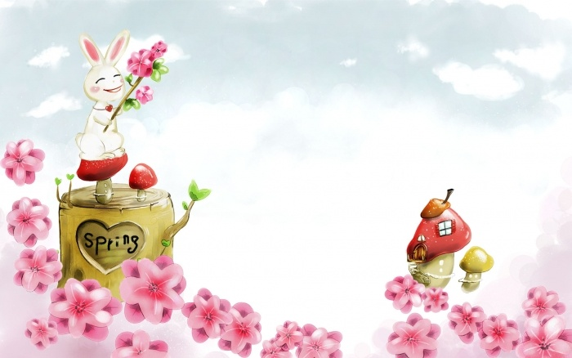
WELCOME TO OUR CLASS

Slide 2

Jumbled words
- yojen →
- penpha →
- verco →
- llupotoni →
- wodo →
- ttlebo →
enjoy
happen
cover
pollution
wood
bottle

Slide 3


Unit 6: THE ENVIRONTMENT
Lesson 3 :READ

Slide 4

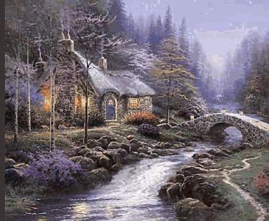
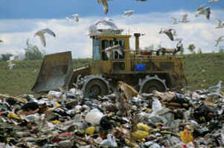
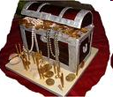
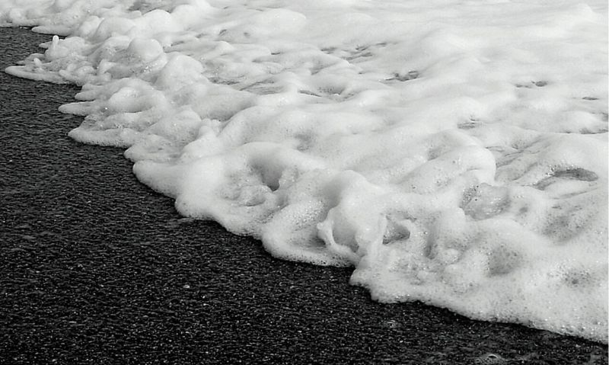
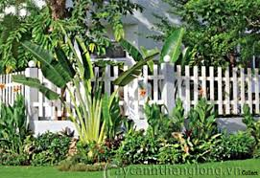
Unit 6 : THE ENVIRONMENT – LESSON 3: READ
New words
1. a junk-yard:
bãi phế liệu
2. a treasure:
kho báu
3. foam (unc.N ):
bọt
4. a hedge:
hàng rào
5. a stream:
dòng suối

Slide 5
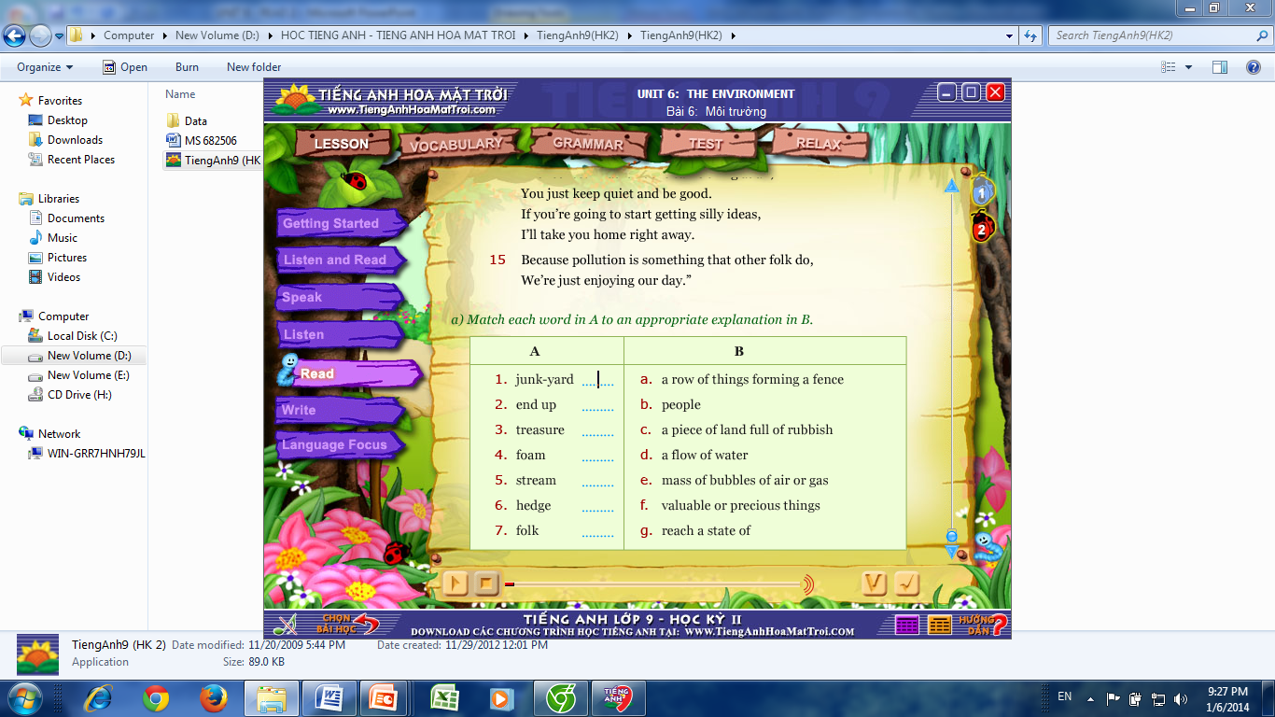
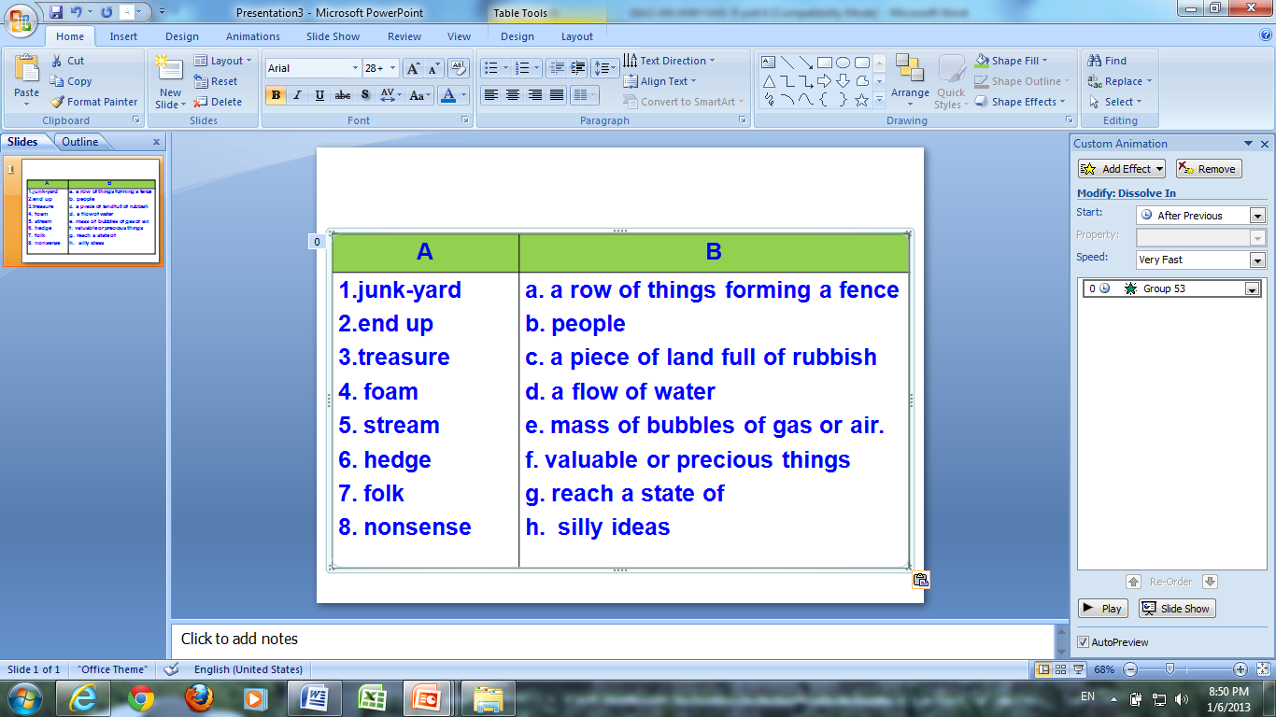
Unit 6 : THE ENVIRONMENT – LESSON 3: READ

Slide 6
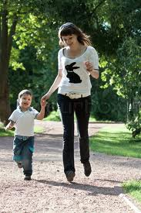
Unit 6 : THE ENVIRONMENT – LESSON 3: READ
Mother and son
They are walking in the park.
They are talking about the pollution of the environment.

Slide 7
Unit 6 : THE ENVIRONMENT – LESSON 3: READ
Soda bottles
Tins
What causes the pollution?
Plastics
Foam

Slide 8
Unit 6 : THE ENVIRONMENT – LESSON 3: READ
Questions:
1. According to the mother, what will happen if the pollution goes on?
2. Who does the mother think pollution the environment?
3. What will happen to the boy if he keeps on asking his mother such questions?
4. Do you think the boy’s question (lines 9 – 10) is silly? Why not?
5. What does the poet want us to learn about keeping the environment unpolluted?

Slide 9

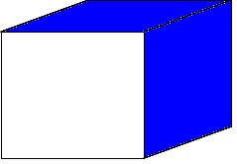
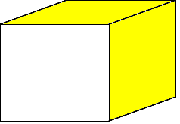


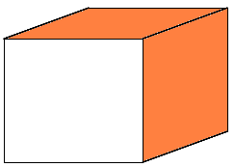


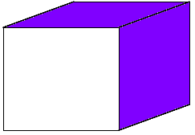
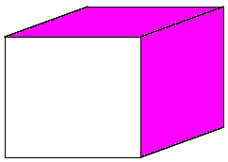




1
8
2
Lucky numbers !
7
5
3
6
4
50
10
20
40
70
60
30
50
10
70
60
40
20
30
Produc.
A
B

Slide 10
Unit 6 : THE ENVIRONMENT – LESSON 3: READ
Pair work: asking and answering the questions
1. According to the mother, what will happen if the pollution goes on?
→ The world will end up like a second-hand junk yard.
2. Who does the mother think pollution the environment?
→ The mother thinks other folk pollute the environment.
3. What will happen to the boy if he keeps on asking his mother such questions?
→ His mother will take him home right away.
4. Do you think the boy’s question (lines 9 – 10) is silly? Why not?
→No. If he throws the bottles that will be polluting the woods.
5. What does the poet want us to learn about keeping the environment unpolluted?
→The poet wants us to learn that everyone is responsible for keeping the environment from pollution.

Slide 11





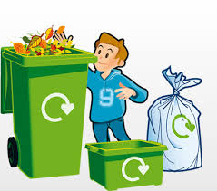
DISCUSSION
Unit 6 : THE ENVIRONMENT – LESSON 3: READ
What could you do in your school / house to minimize pollution?
*Suggested ideas:
We should:
- Clean the yard every day
- Put the garbage bin around the school yard ( the house)
- Pick up the rubbish / garbage & throw it into a trash bin.
- Don’t litter the rubbish on the ground or in classroom.
- Sweep & clean the class ( the house) every day.
- plant trees

Slide 12

Homework:
- Learn by heart all the new words.
- Write the answers of questions again.
- Write the discussion on the notebook.
- Prepare Lesson 4: Write – P.52,53
+ Writing a complaint letter.

Slide 13


Thanks for your attention !
HAPPY NEW YEAR 2016
Goodbye. See you again

Slide 14

LUCKY NUMBER
back

Slide 15

1. According to the mother, what will happen if the pollution goes on?
→ If the pollution goes on, the world will end up like a second – hand junk yard.

Slide 16

3. What will happen to the boy if he keeps on asking his mother such questions?
→ His mother will take him home right away.

Slide 17
2. Who does the mother think pollute the environment?
→ The mother thinks other folk pollute the environment.

Slide 18
4. Do you think the boy’s question (lines 9 – 10) is silly? Why not?
→No. Because he is right. If he throws the bottles that will be polluting the woods.

Slide 19

5. What does the poet want us to learn about keeping the environment unpolluted?
→The poet wants us to learn that everyone is responsible for keeping the environment from pollution.

Slide 20
MUMMY, OH MUMMY
“Mummy, oh Mummy, what’s going to happen
If all the pollution goes on ?”
“Well the world will end up like a second-hand junk-yard,
With all of its treasures quite gone.
5. The field will be littered with plastics and tins,
The streams will be covered with foam.
Now throw those soda bottles over the hedge,
Save us from taking them home.”
“But Mummy, oh Mummy, if I throw the bottles,
10. Won’t that be polluting the woods ?”
“Nonsense ! That isn’t the same thing at all,
You just keep quiet and be good.
If you’re going to start getting silly ideas,
I’ll take you home right away.
15. Because pollution is something that other folk do,
We’re just enjoying our day.”

